Slide 1
JNCIS-ENT
Open Shortest Path First (OSPF)

Slide 2
OSPF Areas and Router Types
5
Scaling OSPF

Slide 3
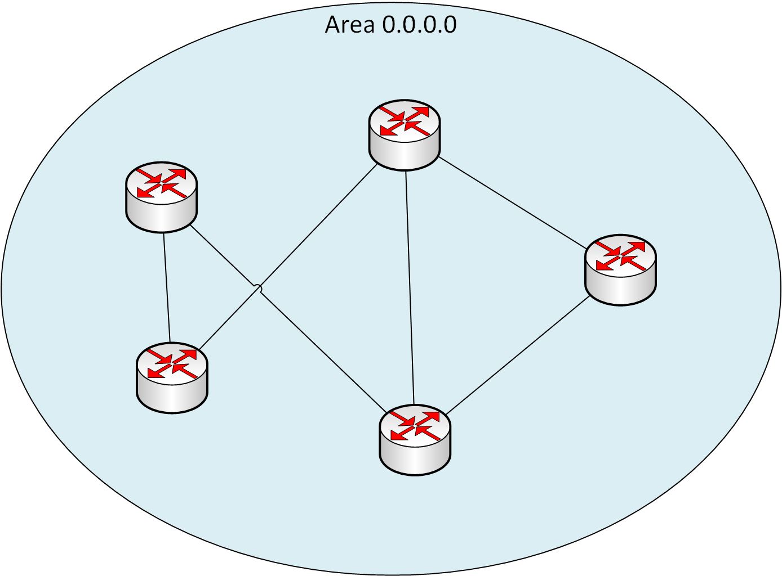
OSPF Scaling Issues
It is a requirement for all routers within an area to have identical LSDBs
All routes will be present in all routers’ tables
Every router within the area must synchronize its LSDB for OSPF to fully converge

Slide 4
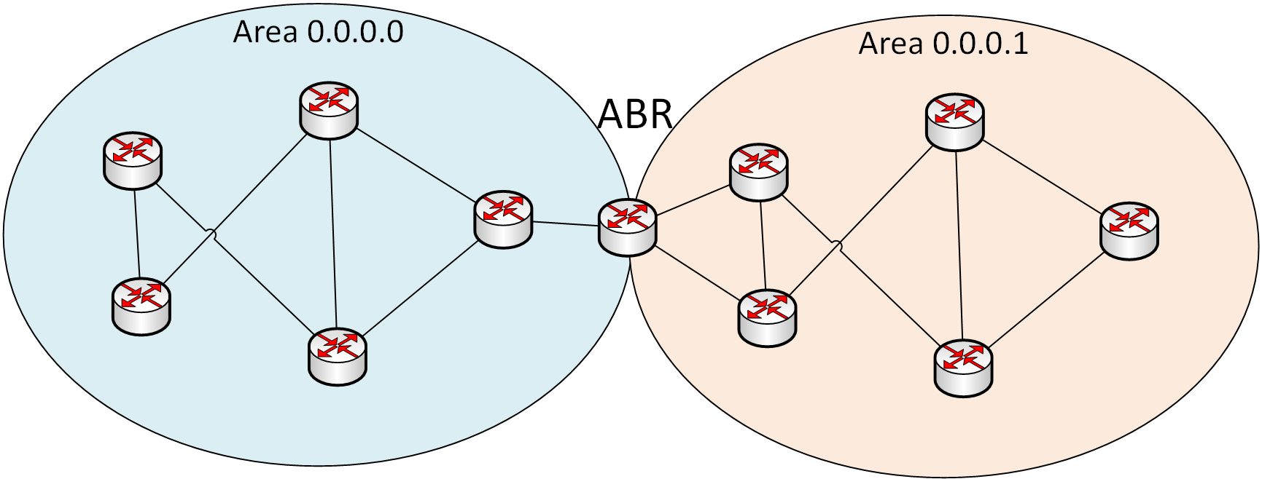
OSPF Areas
Areas allow for partitioning of routing information into smaller sections
Summarization may only be done at area boundaries
An interface of a router is wholly in an area, an ABR has interfaces in multiple areas
Several types of areas exist in OSPF:
Backbone area / general area
Stub area
Not-so-stubby area
Total stub area

Slide 5
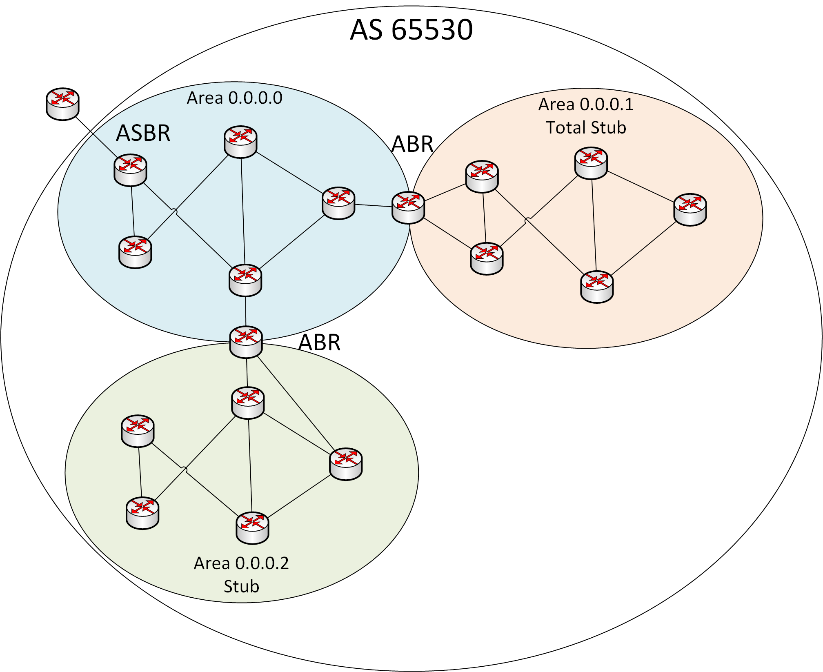
OSPF Router Types
4 Router Types exist in OSPF:
DR / BDR:
These routers are elected on a single broadcast domain to limit LSA flooding
Area Border Router (ABR)
The ABR is a router with interfaces in 2 or more areas. The ABR will originate Type 3 LSAs and control which LSAs are flooded into an area
Autonomous System Boundary Router (ASBR)
An ASBR is any router which redistributes routing information that’s external to the OSPF domain into OSPF. The ASBR originates a Type 4 LSA for information on how to reach the ASBR as well as a Type 5 LSA for each route that’s distributed into OSPF.
OSPF Router
This router type represents all other OSPF-speaking routers which are not among the types listed above

Slide 6
The Backbone Area
Area 0.0.0.0 is the backbone area
All traffic between other areas must traverse the backbone
All areas must connect to the backbone area

Slide 7
General Area
Only Type 3, 4 and 5 LSAs leak from the backbone area to a general area
Otherwise, general areas work like the backbone area

Slide 8
Stub Area
Must be configured on all routers within the stub area
Only Type 3 LSAs leak from the backbone area to a stub area
ASBRs not allowed in the area as Type 5 LSAs are blocked at the ABR
For external routing information, a Type 3 default route LSA is flooded

Slide 9
Total Stub Area
Only a single Type 3 LSA is flooded with a default route, from the backbone are to the total stub area

Slide 10
Not-So-Stub Area (NSSA)
NSSA areas work exactly the same as Stub areas, however ASBRs are allowed in the NSSA area
ASBRs in an NSSA will advertise the external routes by flooding Type 7 LSAs which are converted to Type 5 at the ABR

Slide 11
Configuring OSPF Areas
lab@SW1> show configuration protocols
ospf {
area 0.0.0.51 {
stub;
interface ge-0/0/1.0;
}
area 0.0.0.0 {
interface ge-0/0/2.0 {
priority 128;
}
}
area 0.0.0.52 {
stub no-summaries;
interface ge-0/0/3.0;
}
area 0.0.0.53 {
nssa {
default-lsa default-metric 10;
no-summaries;
}
interface ge-0/0/4.0;
}
}
Notes:
*DR and BDR will be explained in the next video

Slide 12
Monitoring OSPF Areas
lab@SW1> show ospf interface detail
Interface State Area DR ID BDR ID Nbrs
ge-0/0/2.0 DR 0.0.0.0 10.22.33.1 0.0.0.0 0
Type: LAN, Address: 10.22.33.2, Mask: 255.255.255.192, MTU: 1500, Cost: 1
DR addr: 10.22.33.2, Priority: 128
Adj count: 0
Hello: 10, Dead: 40, ReXmit: 5, Not Stub
Auth type: None
Protection type: None
Topology default (ID 0) -> Cost: 1
ge-0/0/1.0 Waiting 0.0.0.51 0.0.0.0 0.0.0.0 0
Type: LAN, Address: 10.23.44.1, Mask: 255.255.255.0, MTU: 1500, Cost: 1
Priority: 128
Adj count: 0
Hello: 10, Dead: 40, ReXmit: 5, Stub
Auth type: None
Protection type: None
Topology default (ID 0) -> Cost: 1
...

Slide 13
Monitoring OSPF Areas
lab@SW1> show ospf interface detail
Interface State Area DR ID BDR ID Nbrs
...
ge-0/0/3.0 Waiting 0.0.0.52 0.0.0.0 0.0.0.0 0
Type: LAN, Address: 10.23.44.1, Mask: 255.255.255.0, MTU: 1500, Cost: 1
Priority: 128
Adj count: 0
Hello: 10, Dead: 40, ReXmit: 5, Stub
Auth type: None
Protection type: None
Topology default (ID 0) -> Cost: 1
ge-0/0/4.0 Waiting 0.0.0.53 0.0.0.0 0.0.0.0 0
Type: LAN, Address: 10.22.33.2, Mask: 255.255.255.192, MTU: 1500, Cost: 1
Priority: 128
Adj count: 0
Hello: 10, Dead: 40, ReXmit: 5, Stub NSSA
Auth type: None
Protection type: None
Topology default (ID 0) -> Cost: 1

